Slide 1
Controlling a Robot with Hand Gestures
David Schulz & Andrew Ruswick
Notes:
David

Slide 2
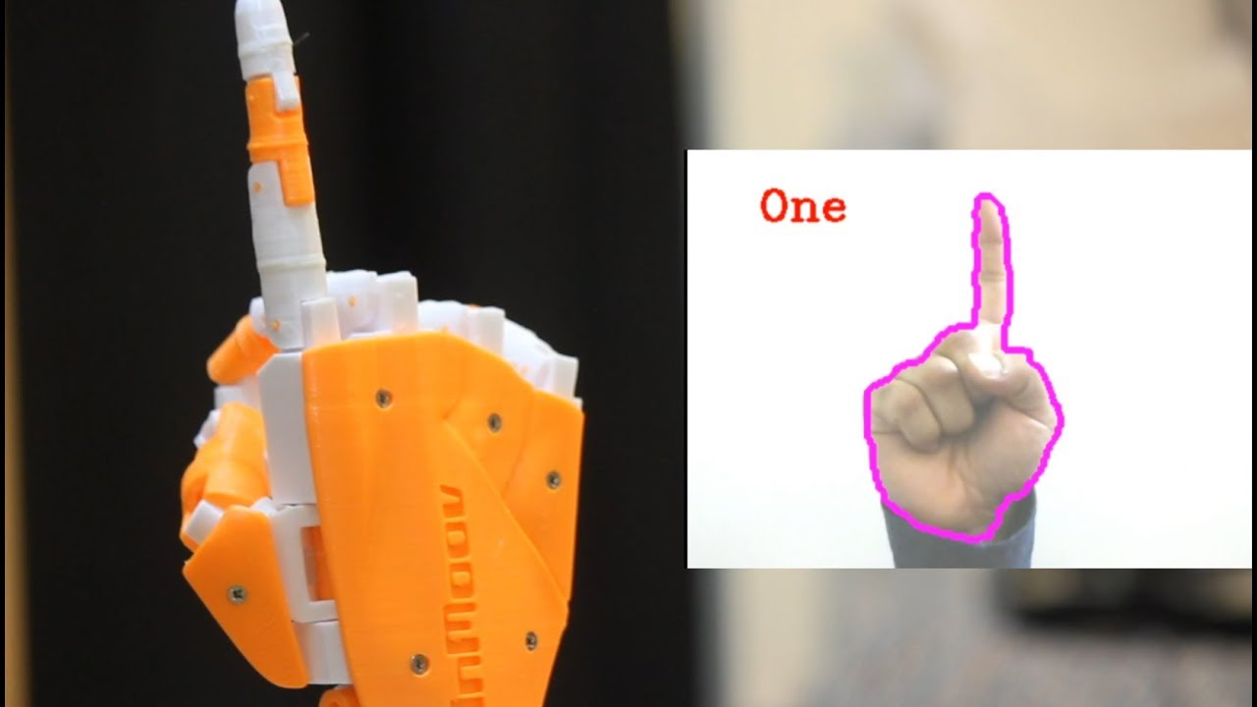
Introduction
Control a robot based on hand gestures/positions
Enables more precise movements
Better human-machine interface
Applications
Bomb defusal/detonation
Radioactive environments
Medical/surgical
Space rovers
People with disabilities
Entertainment
Notes:
David

Slide 3
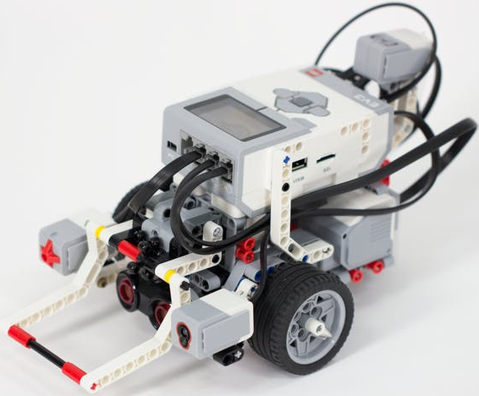

Background
LEGO Mindstorms EV3 Robot
Server-Client control
OpenCV
MediaPipe
Notes:
Andrew

Slide 4
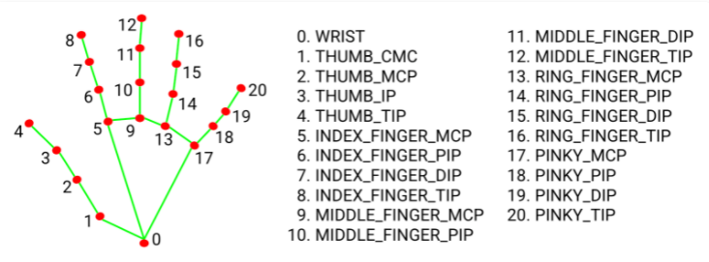
Algorithm Explanation

Slide 5
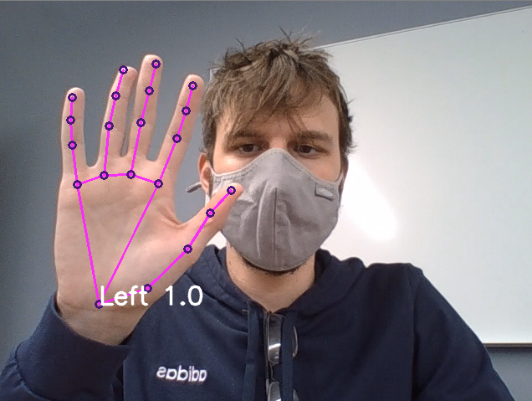
Results
Notes:
Andrew

Slide 6
Live Demo
Notes:
Andrew

Slide 7
Discussion
Pros
Can allow for extreme precision
Improved human-machine interface
Robot can be remotely controlled from a distance
Cons
Requires sophisticated robot to be effective
Requires high speed image processing
Requires camera with enough resolution
Sensitive to noise in image processing
Notes:
David

Slide 8
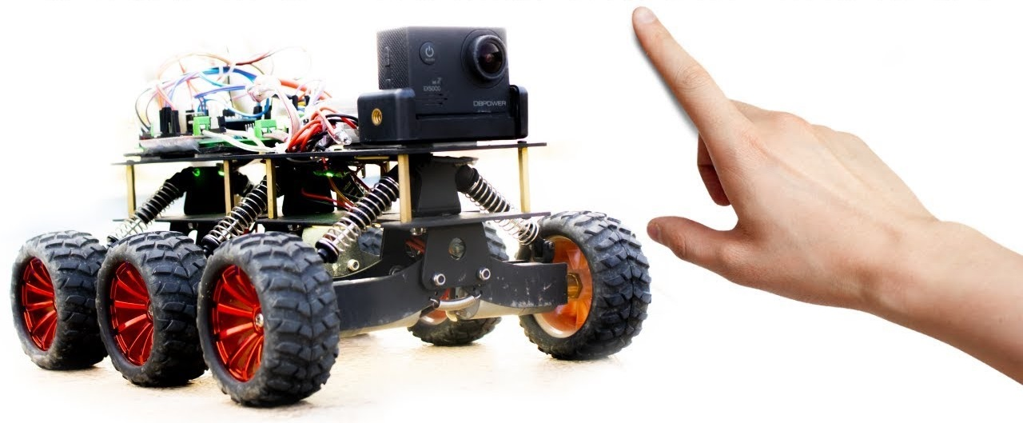
Conclusion
Allows for precise robot movements
Effective if robot is sophisticated enough
Applications for controlling from a distance
Open source libraries & projects
Notes:
David

Slide 9
References
https://google.github.io/mediapipe/
https://opencv.org/
https://iaeme.com/MasterAdmin/Journal_uploads/IJMET/VOLUME_9_ISSUE_3/IJMET_09_03_042.pdf
https://www.ijser.org/researchpaper/A-Gesture-Controlled-System.pdf

